Slide 1
AVL (Adelson-Velsky and Landis) Tree
Bill
Notes:
AVL tree 是一种 self-balancing binary search tree

Slide 2
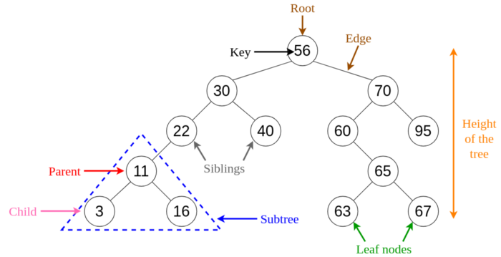
Binary Search Trees
If we have a sequence {56, 30, 22, 70, 40, 60, 95, 65, 11, 3, 16, 63, 67}, we can form a BST
Search time complexity of Binary search is O(log2 n)
Image if from https://levelup.gitconnected.com/an-into-to-binary-search-trees-432f94d180da
Notes:
Tree
Binary Tree
BST (bin search)
AVL

Slide 3
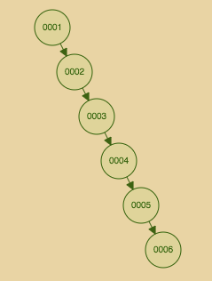
Binary Search Trees
What if we have a sequence {1, 2, 3, 4, 5, 6, …}, the BST we built will be highly imbalanced
Time complexity becomes O(n) rather than O(log2 n)
https://www.cs.usfca.edu/~galles/visualization/AVLtree.html
Notes:
查找就很慢, 进一步影响插入, 删除等操作

Slide 4
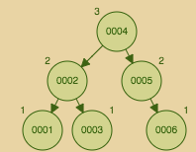
Balanced Binary Search Trees
In order to solve this problem, we have balanced BST
Notes:
平衡后就可以用 binary search 了 --- avl

Slide 5
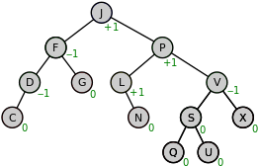
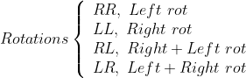
AVL Tree --- a self-balancing binary search tree
(1) We hope |BalanceFactor| < 2
(2) Rotation operations
Notes:
Rotations
\left\{
\begin{array}{lr}
RR,\ Left\ rot \\
LL,\ Right\ rot \\
RL,\ Right+Left\ rot \\
LR,\ Left+Right\ rot \\
\end{array}
\right.

Slide 6

AVL Tree --- An intuitive view
(1) We hope |BalanceFactor| < 2
(2) Rotation operations
The gif is from https://en.wikipedia.org/wiki/AVL_tree

Slide 7
Tips of AVL Tree
(1)* Classification (RR, LL, RL, LR)
(2) Take over (Left rot, Right rot)
(3) Delegation (RL, LR)
Notes:
归纳一下
Take home msg

Slide 8
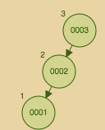
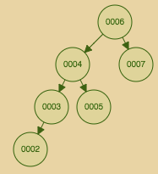
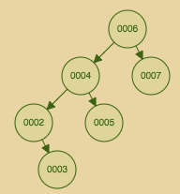
LL (Left-Left)
BalanceFactor = -2
BalanceFactor = -2
BalanceFactor = -2
(I)
(II)
(III)

Slide 9
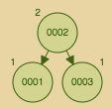
LL (Left-Left) --- I
Take over
Null
(I)
Notes:
类似锁链，提起中间一环

Slide 10
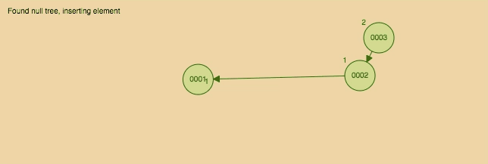
LL (Left-Left) --- I
Take over
Null

Slide 11
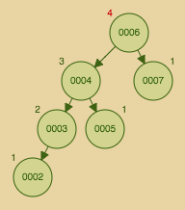
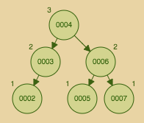
LL (Left-Left) --- II
Take over
(II)
Notes:
比如坐在图书馆，或者咖啡厅，然后有人过来占了你的位子

Slide 12
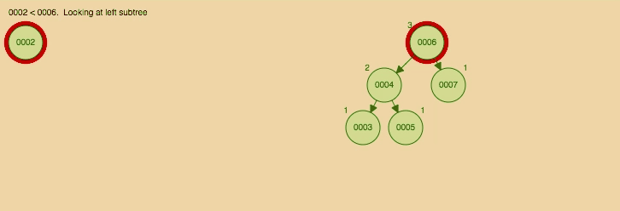
LL (Left-Left) --- II
Take over

Slide 13
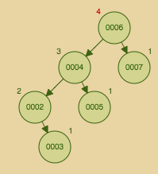
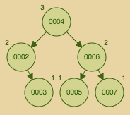
LL (Left-Left) --- III
Take over
(III)

Slide 14
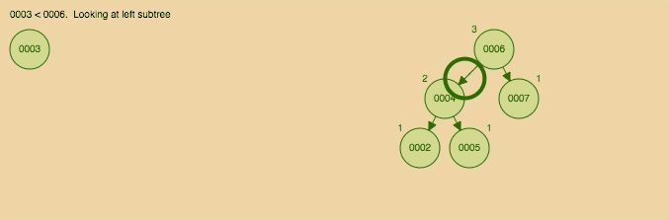
LL (Left-Left) --- III
Take over

Slide 15
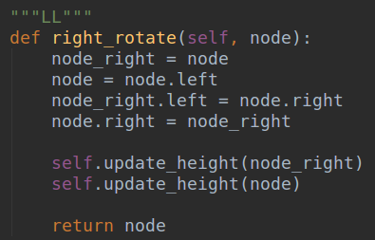
LL (Left-Left) --- Code
node_right
node

Slide 16
LL (Left-Left) --- Code
node_right
node
Take over

Slide 17
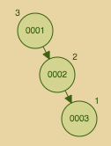
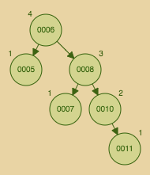
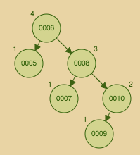
RR (Right-Right)
RR is the MIRROR case of LL
BalanceFactor = 2
BalanceFactor = 2
BalanceFactor = 2
(I)
(II)
(III)

Slide 18
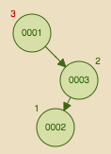
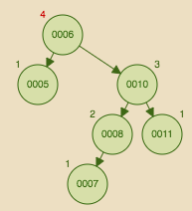
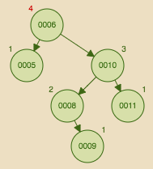
RL (Right-Left)
BalanceFactor = 2
BalanceFactor = 2
BalanceFactor = 2
(I)
(II)
(III)

Slide 19

RL (Right-Left) --- I
RR
Delegation
Left rot
(I)

Slide 20
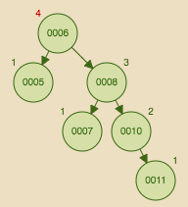
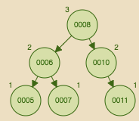
RL (Right-Left) --- II
RR
Delegation
Left rot
(II)

Slide 21
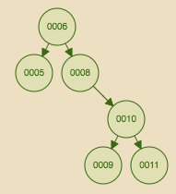
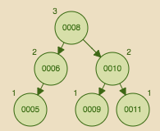
RL (Right-Left) --- III
RR
Delegation
Left rot
(III)

Slide 22
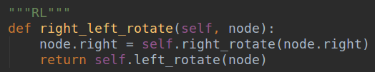
RL (Right-Left) --- Code
RR
Delegation
Left rot

Slide 23
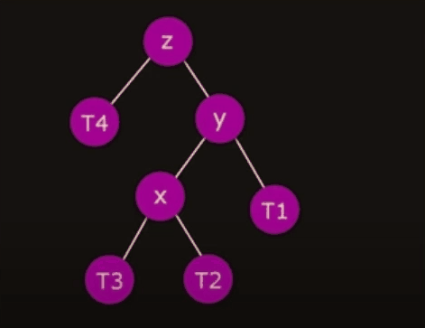
RL (Right-Left) --- Intuition
The gif is made from https://www.youtube.com/watch?v=ygZMI2YIcvk&feature=emb_title

Slide 24
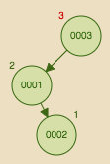
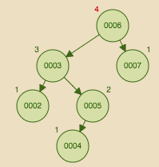
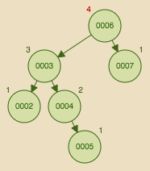
LR (Left-Right)
LR is the MIRROR case of RL
BalanceFactor = -2
BalanceFactor = -2
BalanceFactor = -2
(I)
(II)
(III)

Slide 25

Case Study --- insert
If we have a sequence {12, 4, 1, 3, 7, 8, 10, 9, 2, 11, 6, 5}

Slide 26
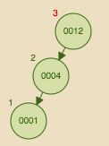
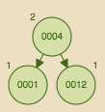
Case Study --- insert
If we have a sequence {12, 4, 1, 3, 7, 8, 10, 9, 2, 11, 6, 5}
LL --- Right rot

Slide 27
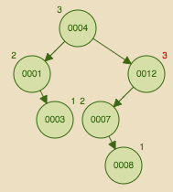
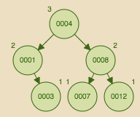
Case Study --- insert
If we have a sequence {12, 4, 1, 3, 7, 8, 10, 9, 2, 11, 6, 5}
LR --- Left + Right rot

Slide 28
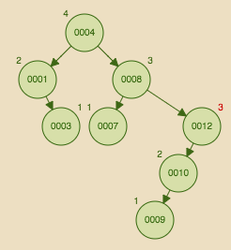
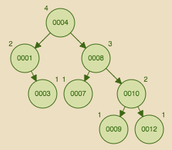
Case Study --- insert
If we have a sequence {12, 4, 1, 3, 7, 8, 10, 9, 2, 11, 6, 5}
LL --- Right rot

Slide 29
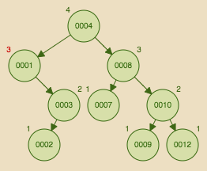
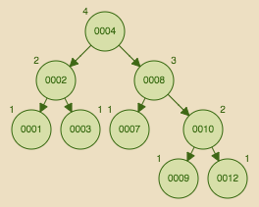
Case Study --- insert
If we have a sequence {12, 4, 1, 3, 7, 8, 10, 9, 2, 11, 6, 5}
RL --- Right + Left rot

Slide 30
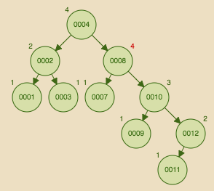
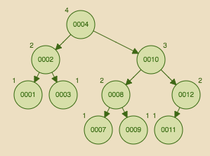
Case Study --- insert
If we have a sequence {12, 4, 1, 3, 7, 8, 10, 9, 2, 11, 6, 5}
RR --- Left rot

Slide 31
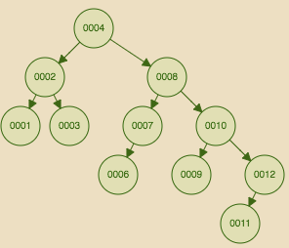
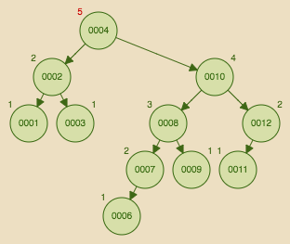
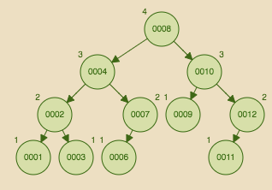
Case Study --- insert
If we have a sequence {12, 4, 1, 3, 7, 8, 10, 9, 2, 11, 6, 5}
RL
Delegation --- Right rot
Left rot

Slide 32
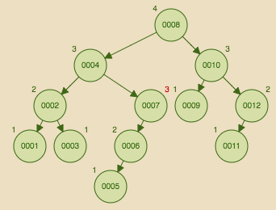
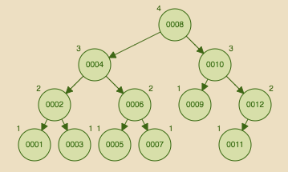
Case Study --- insert
If we have a sequence {12, 4, 1, 3, 7, 8, 10, 9, 2, 11, 6, 5}
LL --- Right rot

Slide 33
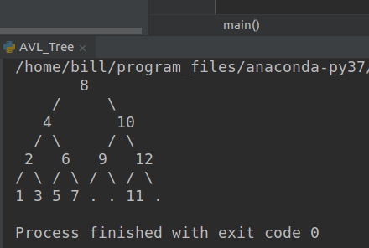
Case Study --- insert
If we have a sequence {12, 4, 1, 3, 7, 8, 10, 9, 2, 11, 6, 5}
The code link will be put in the description section below
Notes:
会将代码和 ppt 链接放到下方 description

Slide 34
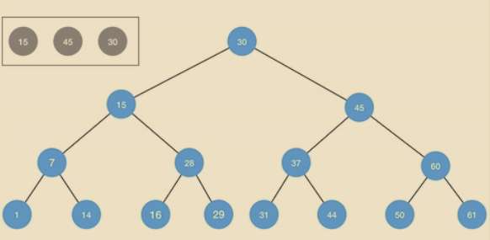
AVL Tree --- delete
Standard BST deletion operation first. For example, if we would like to delete 15 from the tree below
Notes:
In order

Slide 35
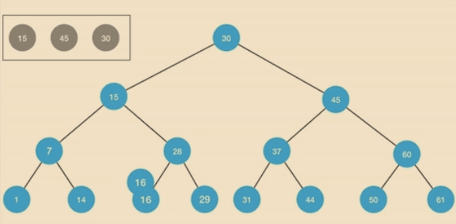
AVL Tree --- delete
If we would like to delete 15 from the tree below

Slide 36

Case Study --- Delete
If we would like to delete 10 from the aforementioned tree

Slide 37

Case Study --- Delete
If we would like to delete 10 from the aforementioned tree

Slide 38

Case Study --- Delete
If we would like to delete 10 from the aforementioned tree

Slide 39
AVL Tree --- complexity analysis
The height of AVL tree is O(logn), where n is the node number
Similar as Binary search
 | Average | Worst case
height | O(logn)
Search | O(logn) | O(logn)
Insert | O(logn) | O(logn)
Delete | O(logn) | O(logn)
Notes:
可以带一句说 DQN 里面 Prioritised experience replay 用了BST，说明复杂度很重要

Slide 40
Thank you!

